Slide 1
AMR Mortality
Friday 6/12/2018

Slide 2
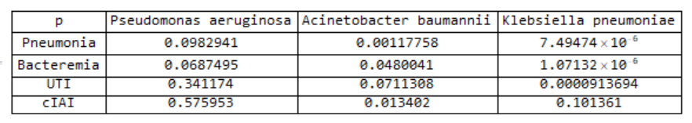
P values

Slide 3
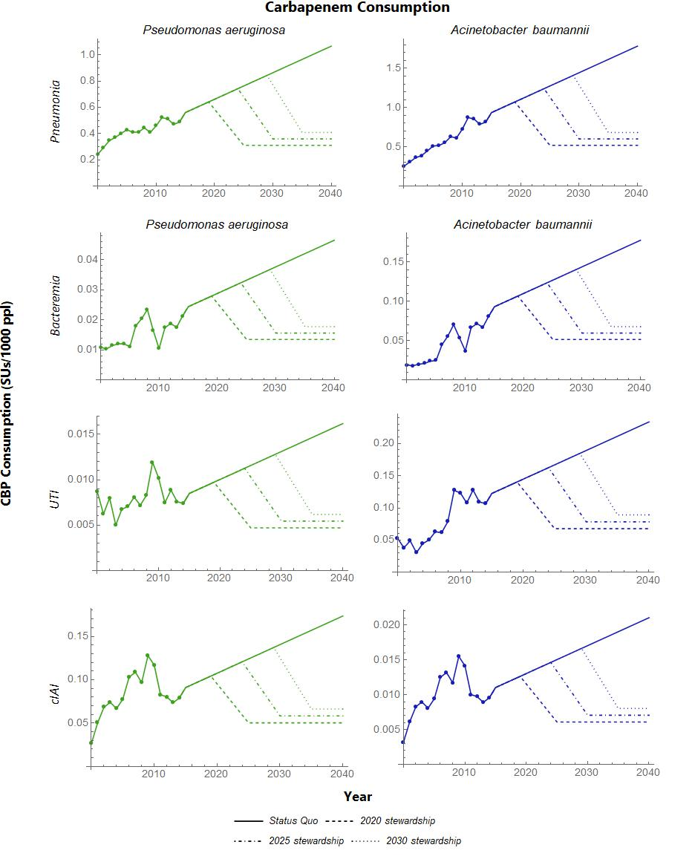
Reduction in inappropriate carbapenem consumption by ~52% from year of intervention
Linear reduction occurs over 5 years

Slide 4
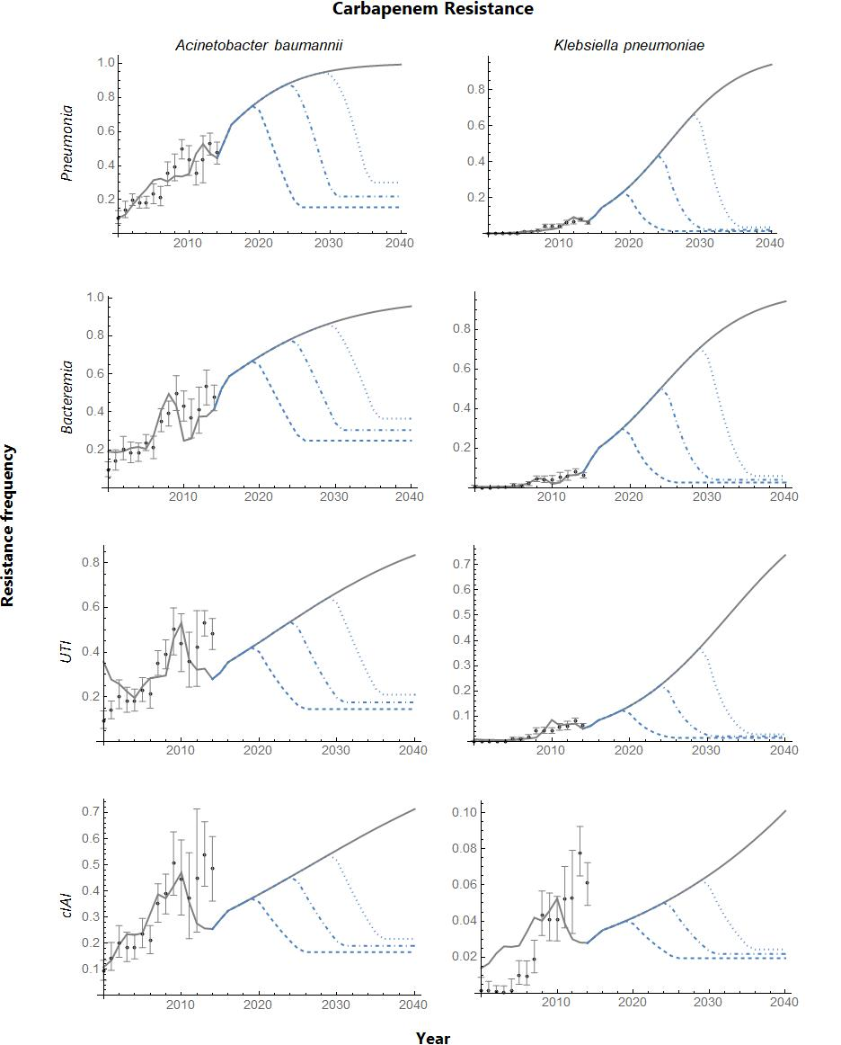

Slide 5
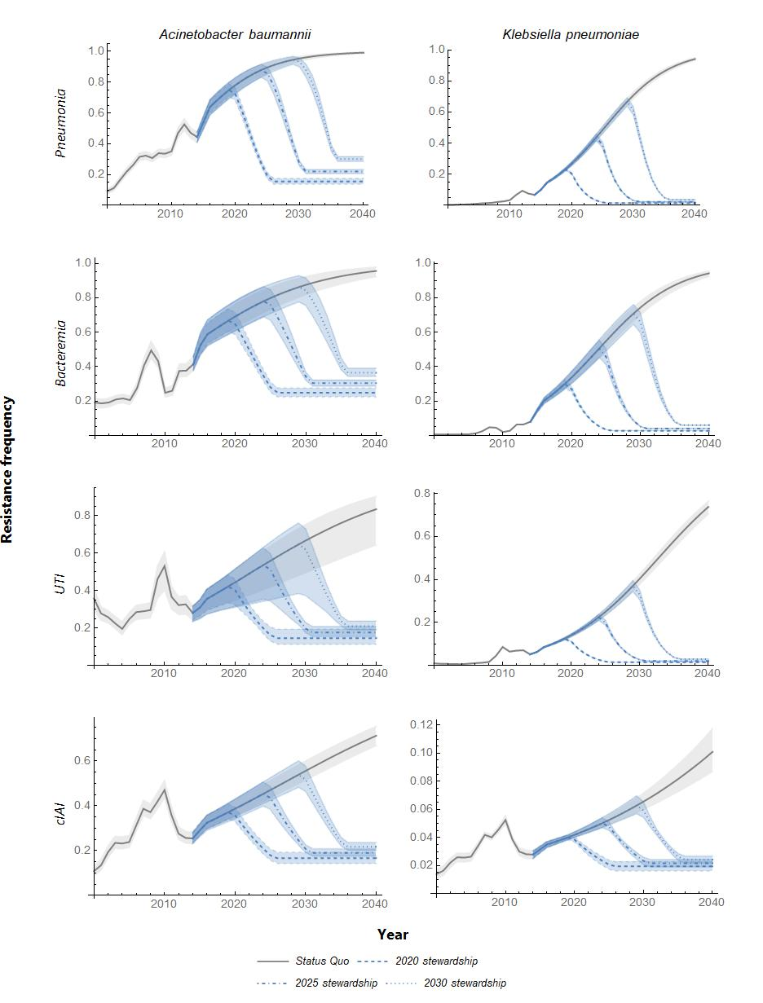

Slide 6
MORTALITY (medians)
 | Pneumonia |  | Bacteremia |  | UTI
 | AB | KP | AB | KP | AB | KP
Status quo | 187,689 | 267,404 | 26,065 | 68,272 | 430 | 8,593
2020 | 228,224 | 301,686 | 24,093 | 51,525 | 617 | 8,952
2025 | 213,263 | 292,132 | 23,505 | 53,981 | 542 | 8,707
2030 | 199,830 | 283,338 | 22,925 | 55,903 | 470 | 8,381
*cIAI not included due to lack of available mortality data

Slide 7
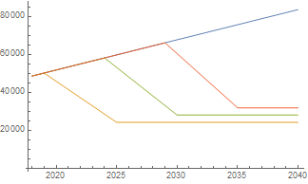
PNEU, AB - # PATIENTS
Alternative therapy
CBP therapy

Slide 8
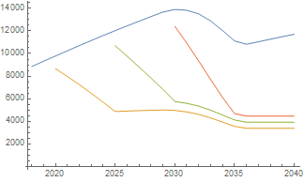
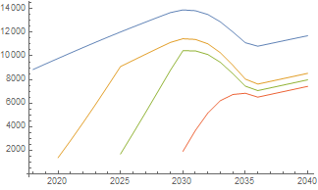
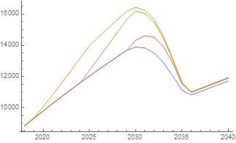
Blue=status quo
+
Mortality attributed to CBPs
Mortality attributed to alternatives
=
PNEU, AB
1 random trial

Slide 9
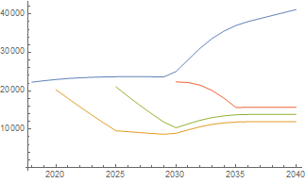
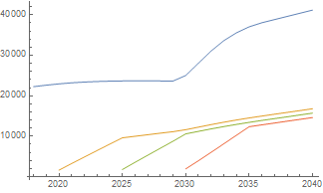
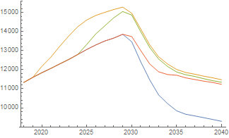
Blue=status quo
+
Mortality attributed to CBPs
Mortality attributed to alternatives
=
PNEU, KP
1 random trial

Slide 10
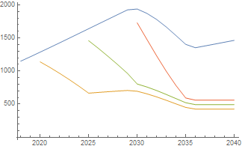
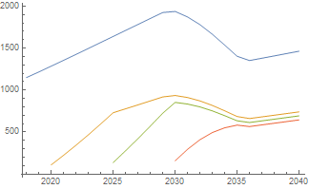
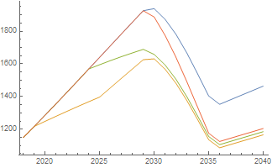
Blue=status quo
+
Mortality attributed to CBPs
Mortality attributed to alternatives
=
BACT, AB
1 random trial

Slide 11
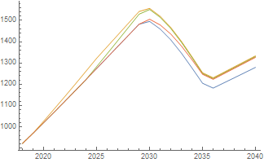
TRIAL 1
TRIAL 2
Vs.
Mortality | R | S
CBP | 0.35 | 0.10
Non-CBP | 0.27 | 0.06
Mortality | R | S
CBP | 0.27 | 0.10
Non-CBP | 0.29 | 0.11
BACT, AB

Slide 12
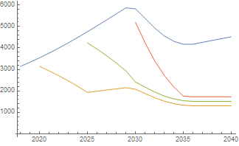
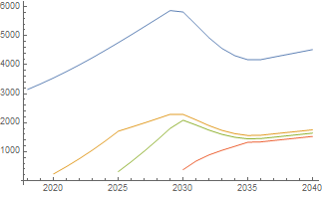
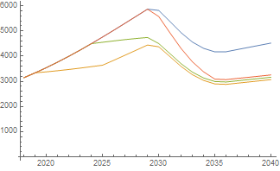
Blue=status quo
+
Mortality attributed to CBPs
Mortality attributed to alternatives
=
BACT, KP
1 random trial

